Slide 1
Introduction Session: Characteristics, Version dilemma, License and installation procedure
STATA
Dr. Anil Shrestha
Undersecretary (Account)
Financial Administration Section
National Statistics Office

Slide 2

What is Stata?

Slide 3

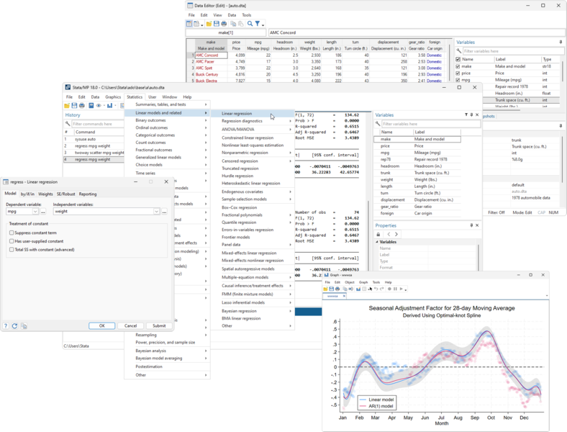
What is Stata?
Stata is a statistical software developed by StataCorp for data manipulation, visualization, statistical analysis, and reporting.
Initial release : 1985
Type : Proprietary (Closed Source)
User-friendly operation : supports both GUI and command-based operations.

Slide 4
STATA vs other statistical software
Feature | R | Python | STATA | SPSS
License | Free and open-source | Free and open-source | Proprietary | Proprietary
User Interface | Command-line, IDEs (RStudio) | Command-line, IDEs (Jupyter, PyCharm) | Graphical user interface (GUI) | Graphical user interface (GUI)
Visualization | Extensive libraries (ggplot2) | Extensive libraries (matplotlib, seaborn) | Basic | Basic
Type | Statistical Analysis | General Purpose Language | Statistical Analysis | Statistical Analysis
Community Support | Large, active community | Large, active community | Smaller, specialized | Moderate
Cost | Free | Free | Paid | Paid
Learning Curve | Steep | Moderate | Relatively easy | Relatively easy
Flexibility | High | High | Moderate | Moderate

Slide 5
STATA Editions
Feature | Stata/BE (Basic Edition) | Stata/SE (Standard Edition) | Stata/MP (Multiprocessor)
Maximum Variables | Up to 2,048 | Up to 32,767 | Up to 120,000
Maximum Observations | Up to 2 billion | Up to 2 billion | Up to 20 billion
Model Variables | Up to 798 | Up to 10,998 | Up to 65,532
Speed | Standard | Faster than BE | Fastest
Core Support | Single-core | Dual-core | Multi-core
Price | Most affordable | Mid-range | Most expensive

Slide 6
Installation

